Slide 1

Guru Gobind Singh College of Engineering and Research Center, Nashik.
Department of Computer Engineering
Academic Year: 2024-25
Final Year Project Work
Review 3.1
Group ID | G-8
Project Title | AI PRESENTATION TOOL USING GESTURE RECOGNITION
Team Members | 1. Ayesha Shaikh
 | 2. Pooja Gupta
 | 3. Shiba Shaikh
 | 4. Anushka Jadhav
Guide Name | Mrs. P. K. Bachhav

Slide 2

Guru Gobind Singh College of Engineering and Research Center, Nashik.
Department of Computer Engineering
Presentation Outline
Process Model
Mathematical Model
Architectural Model
Component Diagram
Deployment Diagram
NP Completeness
Demonstration Of Project
Guru Gobind Singh College of Engineering, Nashik

Slide 3
2.Mathematical Model:
Variables:
T: Total time (in seconds or minutes) spent on a presentation.
G: Number of gestures recognized during a session.
V: Number of voice commands processed.
Acc: Accuracy of gesture recognition (%).
Res: Response time for the system to recognize a gesture or voice command (in seconds).
U: Number of unique users.
R: Resource consumption rate (e.g., CPU usage or memory in MB).
E: System efficiency (%).
Err: Number of errors (misrecognized gestures or commands).
Guru Gobind Singh College of Engineering, Nashik

Slide 4
2.Mathematical Model:
System Efficiency: E= ((G+V)−Err/G+V)×100
Response Time:
Res=Total processing time for interactions / (G+V)
User Engagement:
Engagement=(G+V​​)/T
Error Rate: Error Rate= (Err/(G+V))×100
Resource Utilization: R=Total system resources consumed / T
User Interaction Efficiency: Interaction Efficiency=G+V / U​
Guru Gobind Singh College of Engineering, Nashik

Slide 5
2.Mathematical Model:
Constraints:
G≥ 0 : The number of gestures recognized must be non-negative.
V≥0 : The number of voice commands processed must be non-negative.
Err≥0 : Errors cannot be negative.
Acc≤100: Accuracy cannot exceed 100%.
R>0: Resource consumption must be positive during system operation.
Guru Gobind Singh College of Engineering, Nashik

Slide 6
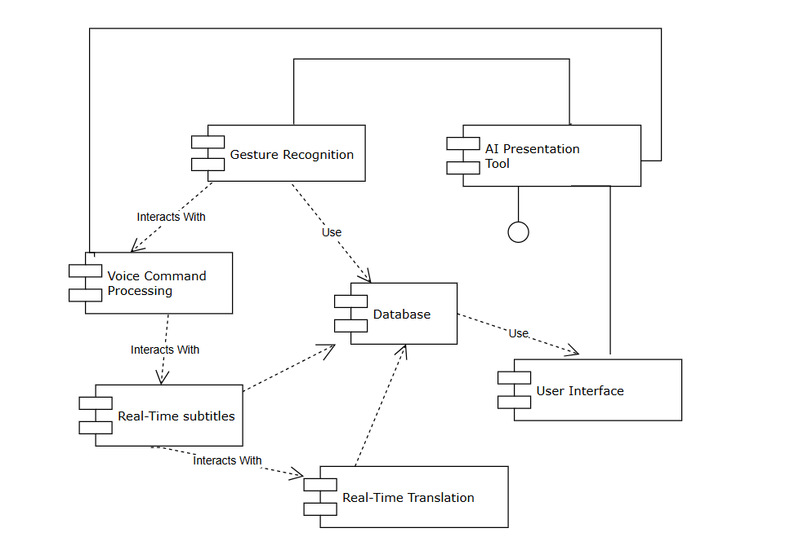
4.Component Diagram:
Guru Gobind Singh College of Engineering, Nashik

